Slide 1
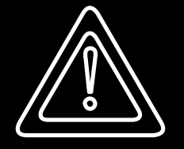
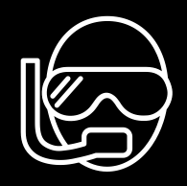
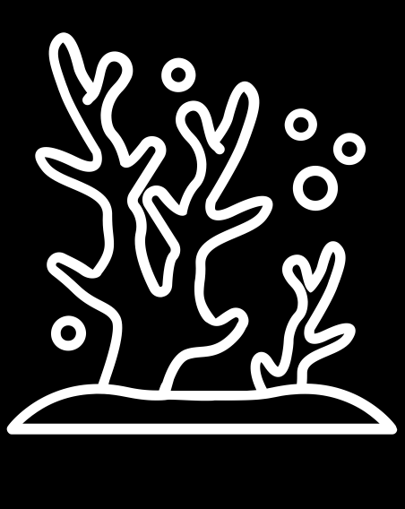
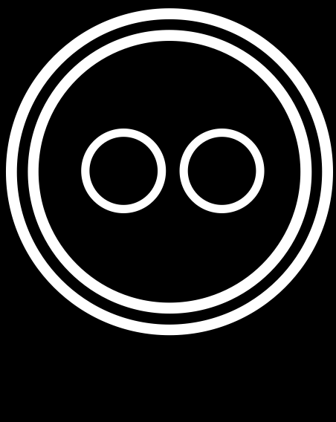
NEPTUNE blue trails
Baie de la Garonne underwater trail
Warning FRAGILE
Snorkelling
Natural
Average frequentation

Slide 2
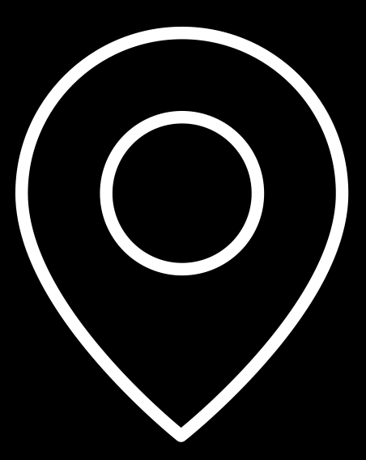
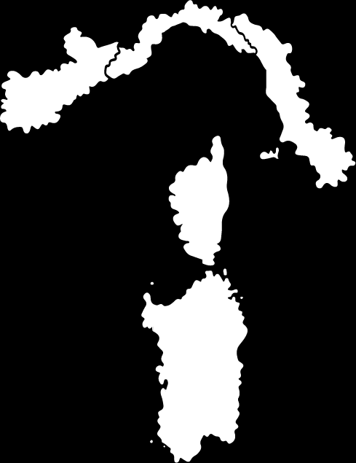
LOCATION
Geographic location
France, Provence Alpes Côte d’Azur, Var, Le Pradet
Name of the conservation area (or protected area)
Marine area adjacent to Port-Cros National Park
Level of environmental protection
No specific level of protection
Name of the dive site
Baie de la Garonne underwater trail
Geographic coordinates (reference system)
LAT
LONG
Reference system
E 06°01'29.615''
N 43°05'31.700''
WGS 84

Slide 3
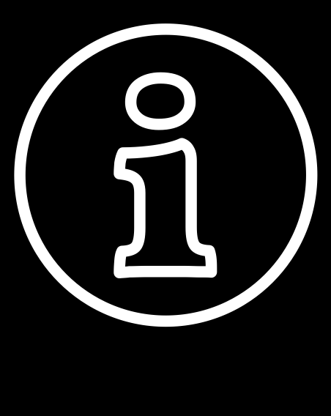
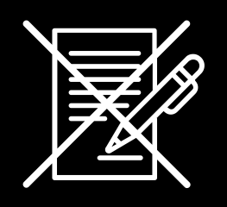
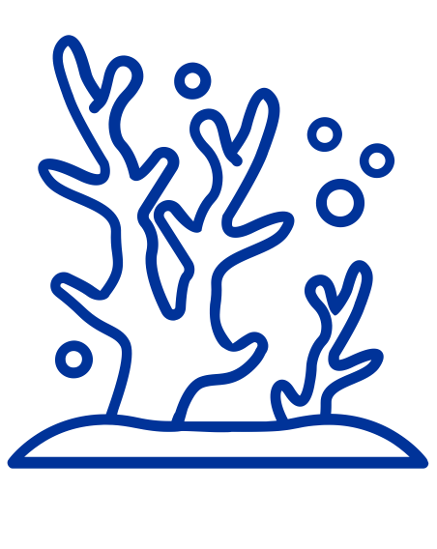
INFORMATION
Access to the dive site
By land: go to the Aquabulles premises located on Garonne beach.
Site characteristics
Authorisation not required
Non richiede permesso
Maximum depth
Difficulty
4 m
Low
Snorkelling
Natural
Information about the managing body
More information:
The underwater trails booklet (trail No.4, page 14)
https://fr.calameo.com/read/000318363320cc568f95e
Aquabulles 83 proposes activities to discover the underwater habitat, notably on the Baie de la Garonne underwater trail. This trail is marked by explanatory buoys to inform the public about underwater life.
Contact: the Aquabulles association www.aquabulles-plongee.fr
Telephone: (+33) 6 13 49 24 18 Email: aquabulles83@aol.com

Slide 4
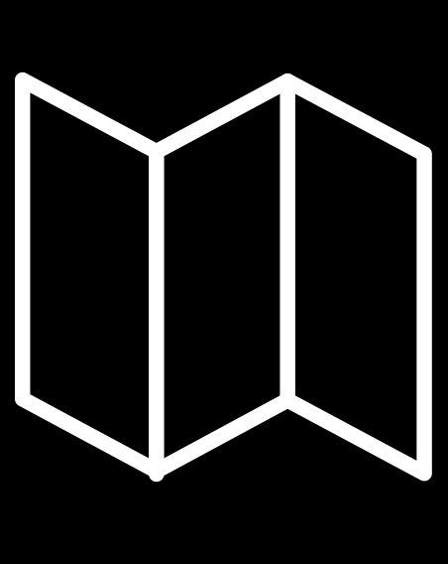
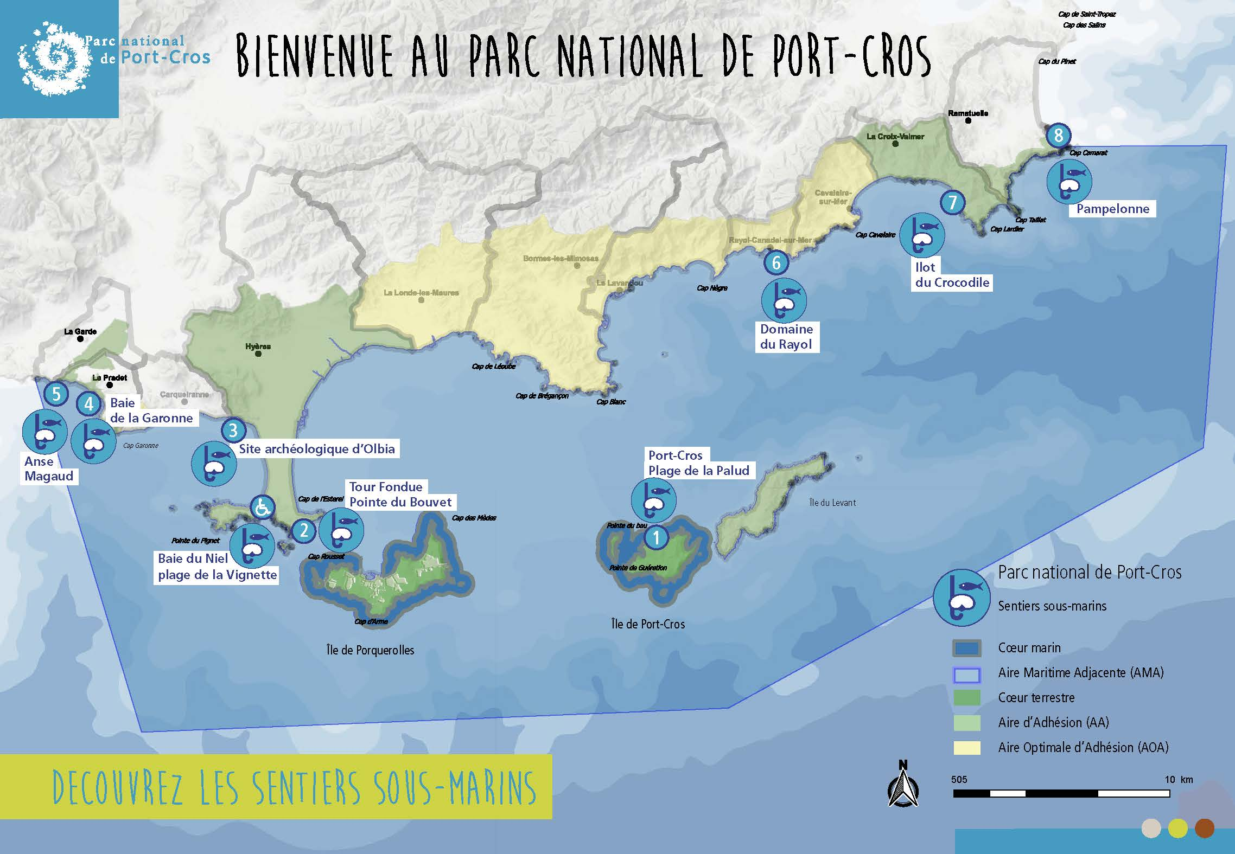
TRAIL MAP
Warning FRAGILE
To preserve biodiversity
IT IS PROHIBITED
to gather sea urchins from 16 April to 31 October in the department of Var
to capture or hunt octopus from 1 June to 30 September
to fish or hunt in the zones reserved for swimming, including the underwater trails

Slide 5
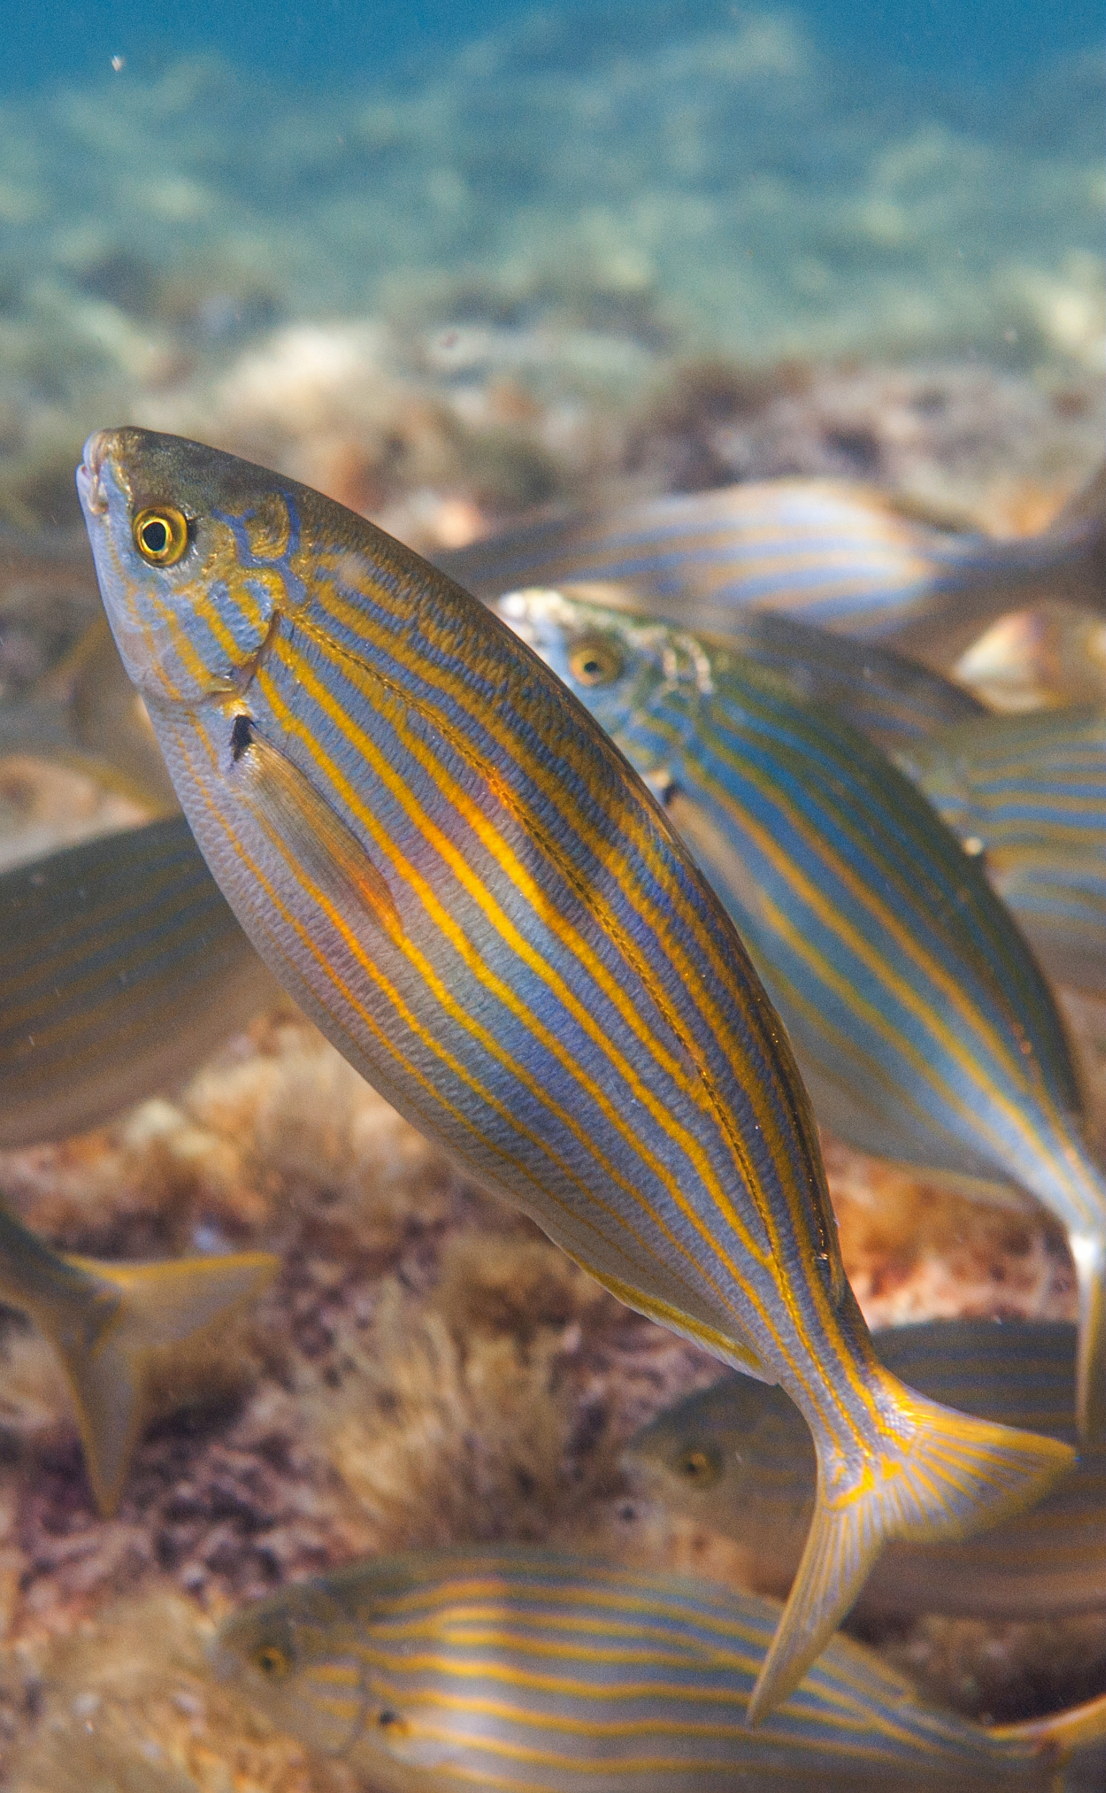
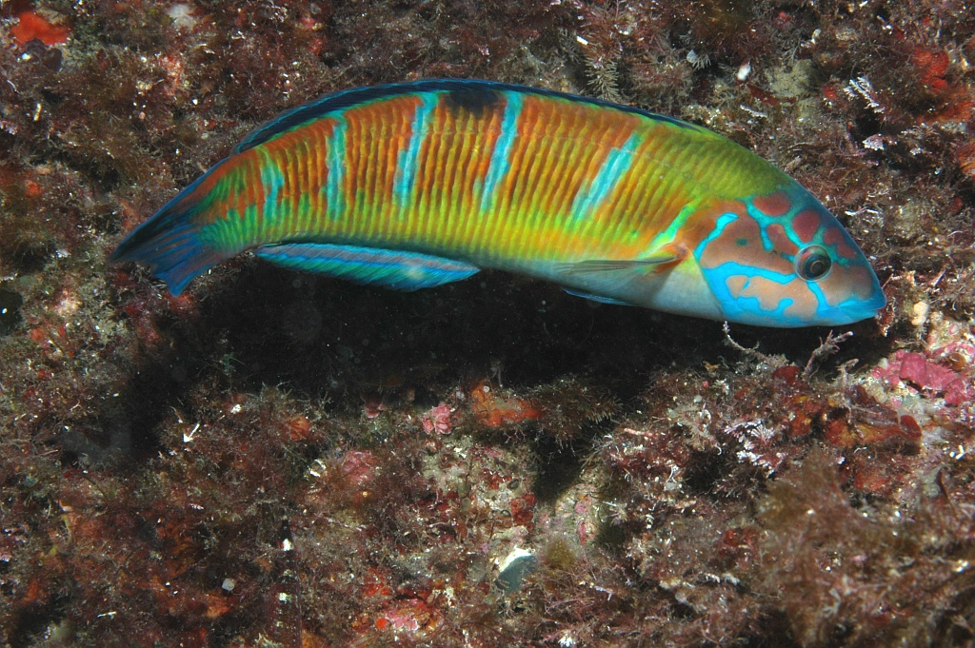
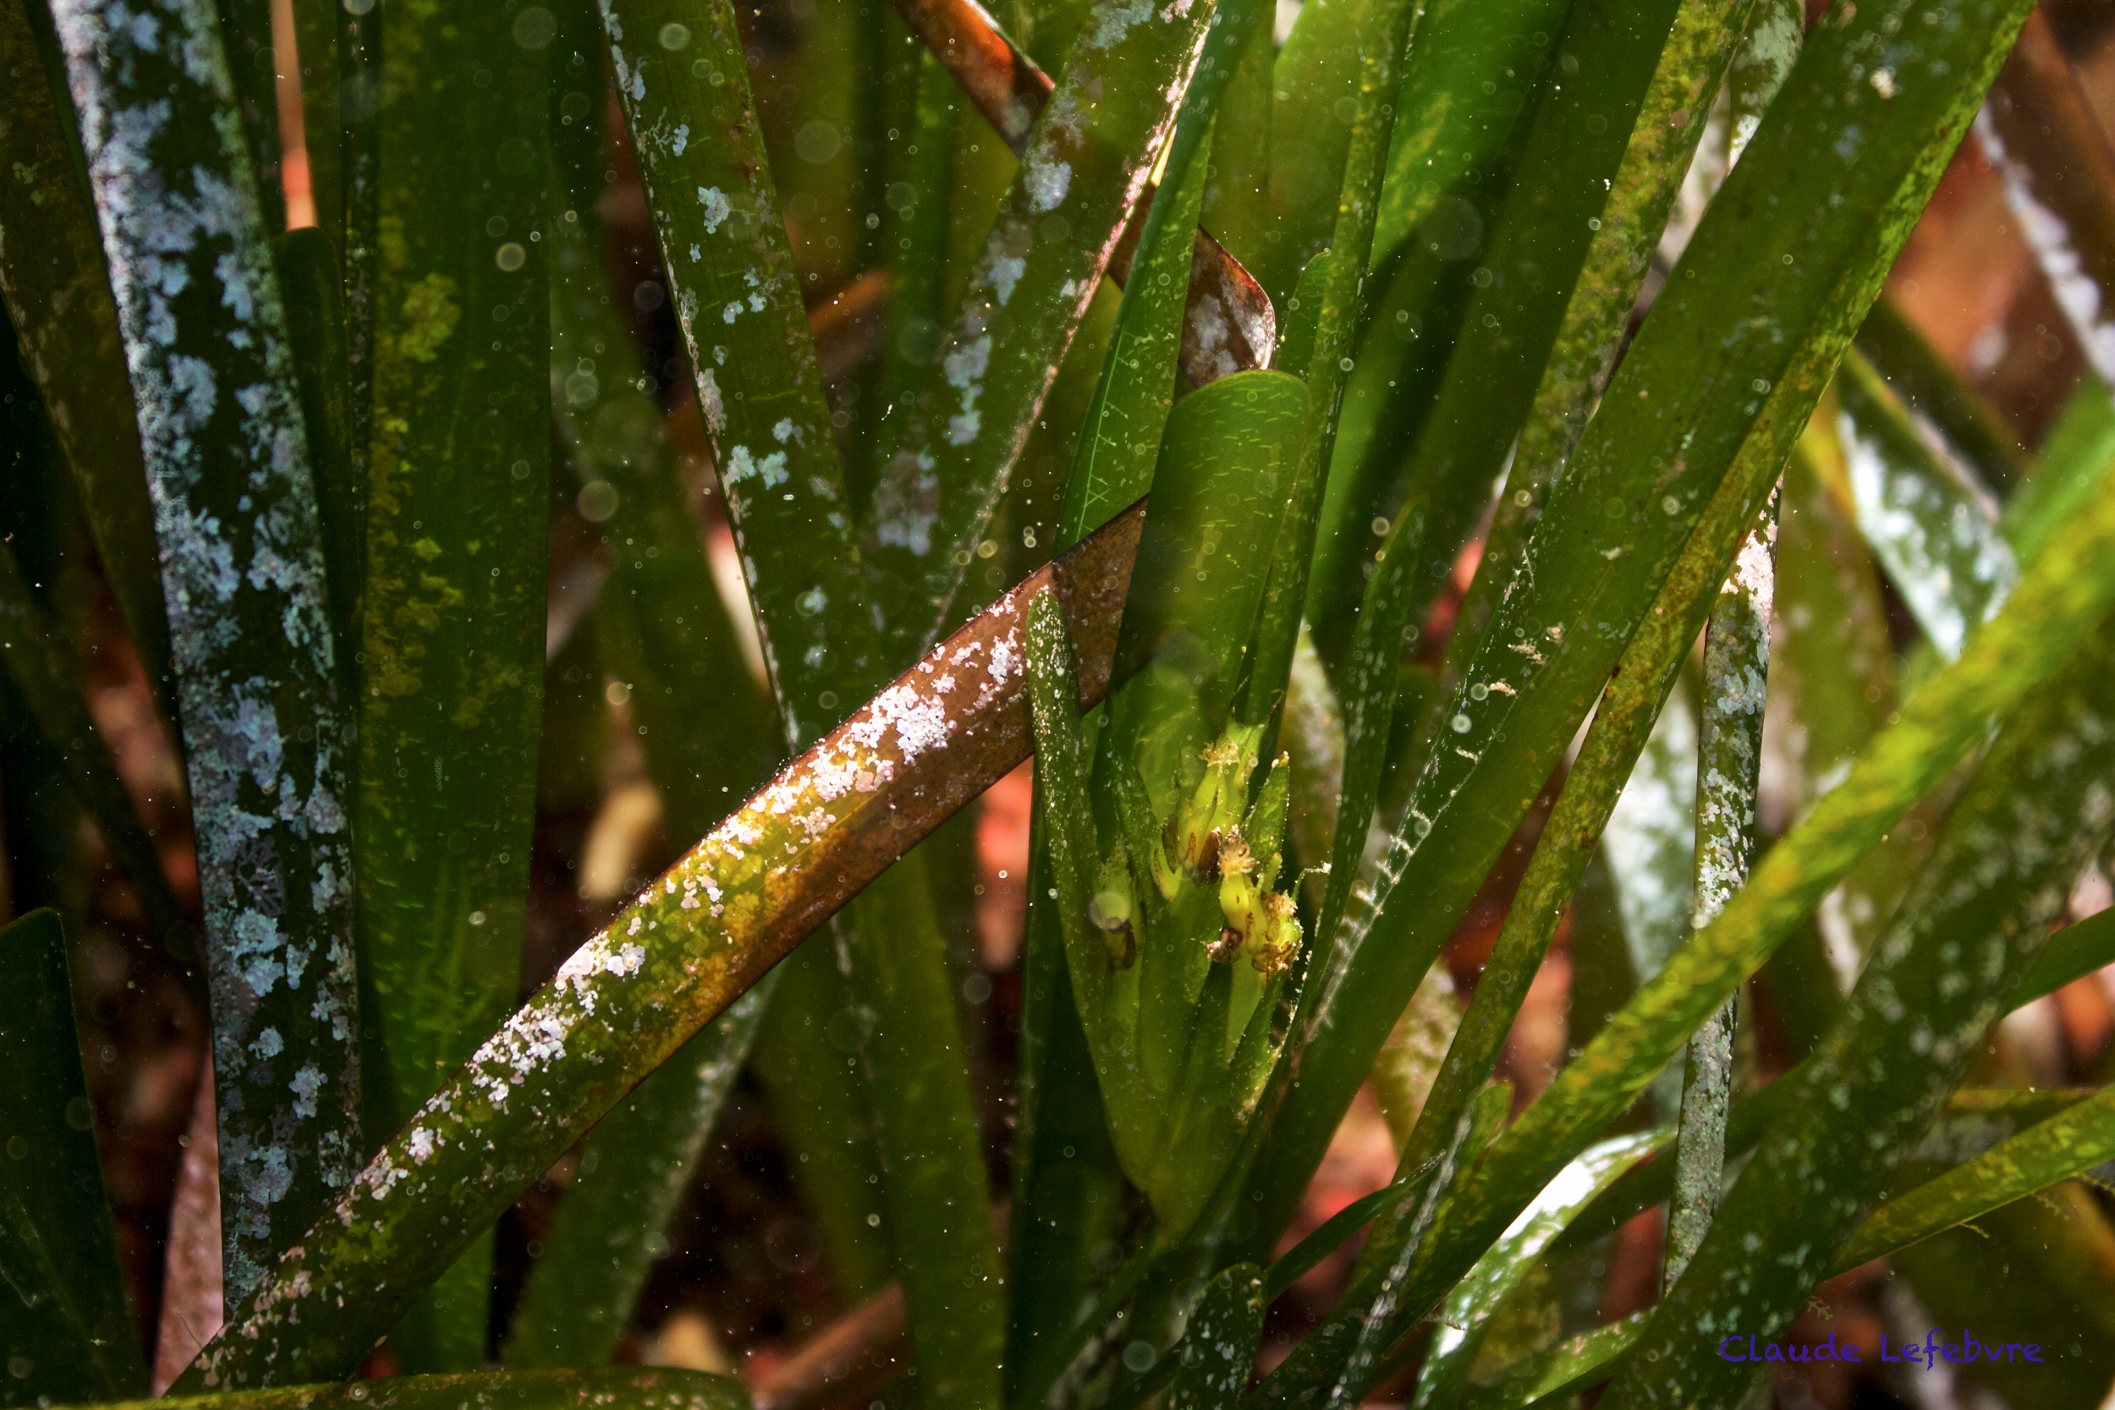
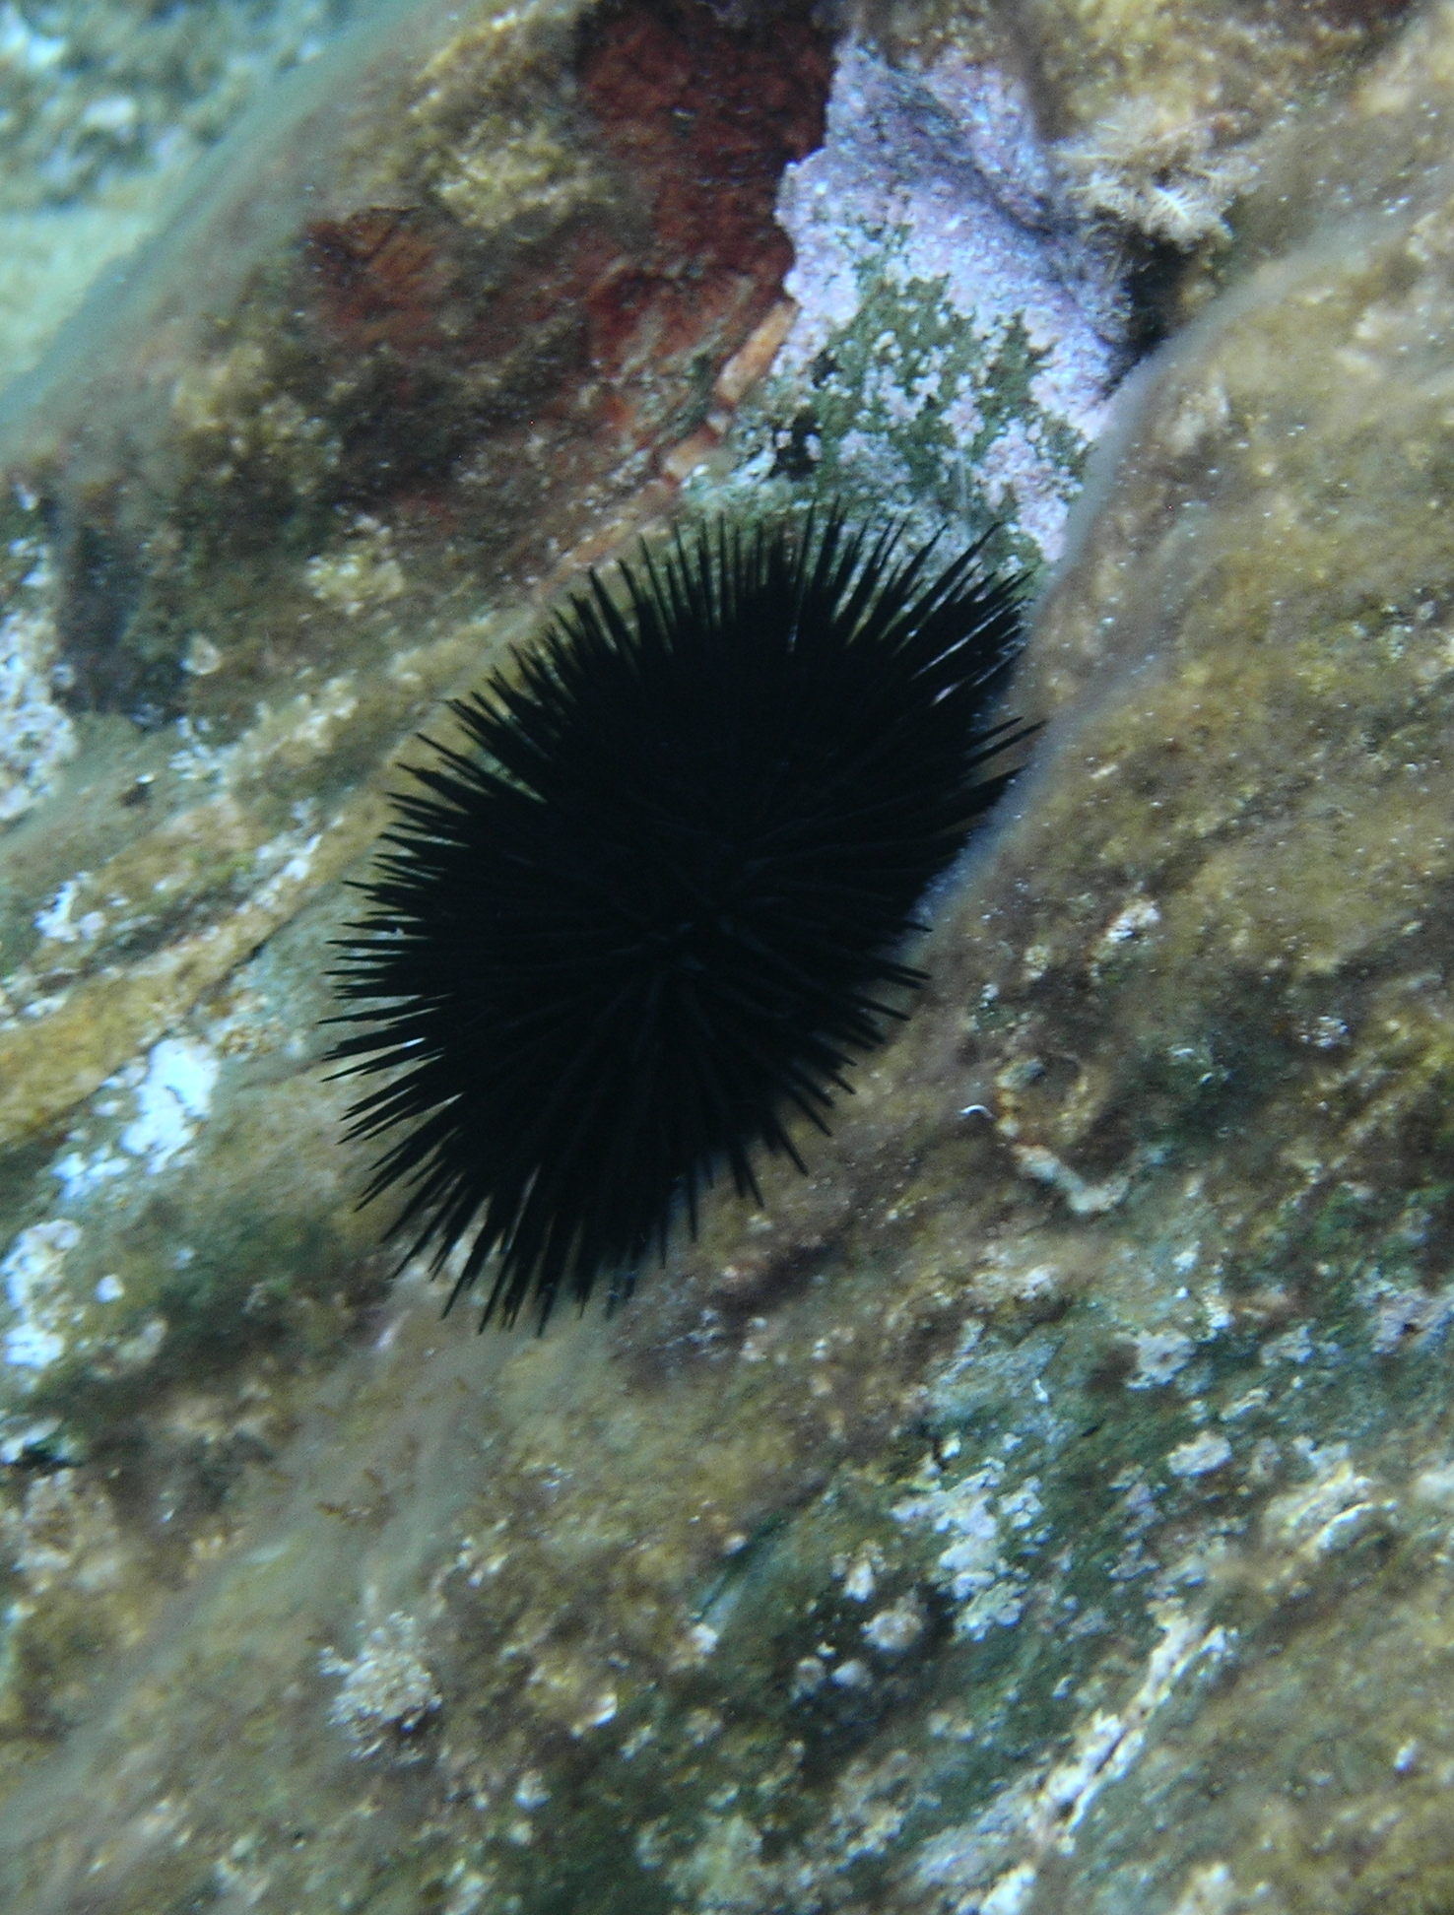
NATURAL
Description of the site of natural interest
The Garonne underwater trail consists of several types of habitat (rocks, meadows, open water) that enable the observation of a wide variety of species. Each habitat has its own educational buoy.
List of main species
Ornate wrasse
Octopus vulgaris
• Snakelocks anemone Anemonia viridis
• Damselfish Chromis chromis
• Green sponge ball Codium bursa
• Peacock wrasse Symphodus tinca
• Red sea star Echinaster sepositus
• Ornate wrasse Thalassoma pavo
Green wrasse Labrus viridis
• Black sea urchin Arbacia lixula
Neptune grass Posidonia oceanica
• Painted comber Serranus scriba
• Salema porgy Sarpa salpa
• Common two-banded sea bream Diplodus vulgaris
Salema porgy
Sarpa salpa
PNPC ©Vincent Bardinal
Parc national de Port-Cros © Déclic Bleu Méditerranée
Black sea urchin
Arbacia lixula
Parc national de Port-Cros ©Claude Lefebvre
Neptune grass
Posidonia oceanica
PNPC ©Marine Colombey

